Slide 1
Racial Disparity in Housing

Slide 2
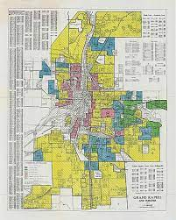
How did we get where we are today?
The Color of Law (Richard Rothstein)
15 minute presentation: https://www.youtube.com/ watch?v=8ddQCCPhXB0

Slide 3
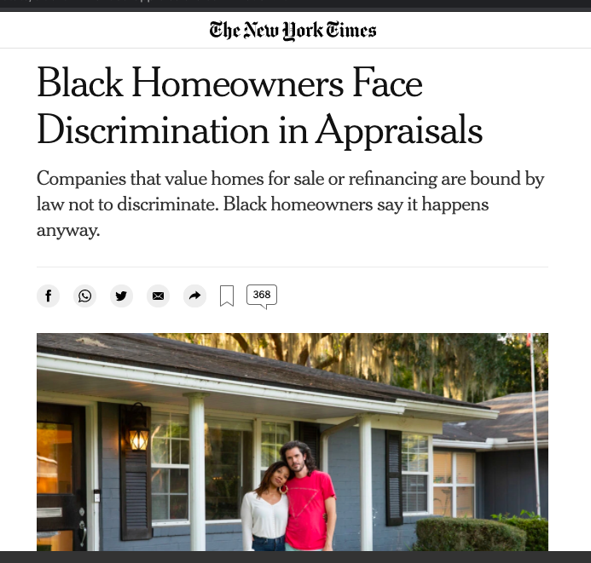
What’s still happening?

Slide 4
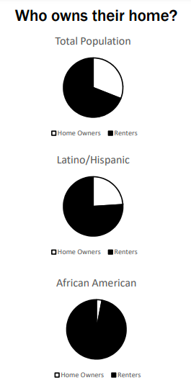
Closer to home…
Belknap Lookout is (with aggressive rounding for a simple infographic) 60% white, 20% Hispanic, and 20% African American.
Homeownership breakdown provided by www.blackdemographics.com

Slide 5
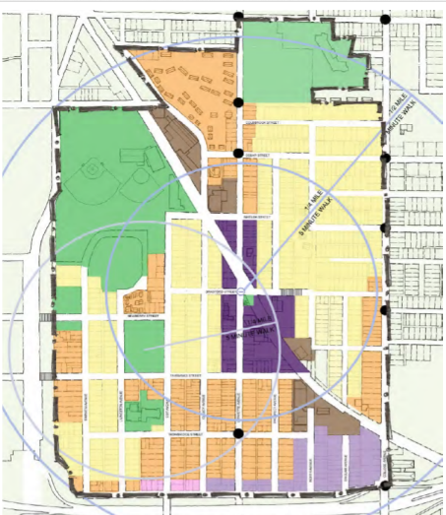
Looking ahead: Monday November 14 Annual Meeting – Increasing Supply thru Zoning

Slide 6
Outside of our homes, are we ready to change how things look, too?
Chain link fence is illegal to install new for a front yard.
Natural lawns are not permitted.
These ordinances police poverty! Plus, as the climate crisis gets worse, grass lawns are less and less sustainable.

Slide 7
Did you know?
Racial discrimination in rental practices is still a problem.
Join us again on Monday December 5 at 11 am for another hybrid Lunch N Learn, this time with Liz Keegan from the Fair Housing Center of West Michigan.
______________________________
Learn about Environmental Racism: https://detroitenvironmentaljustice.org/grand-rapids-report/
Intern Hannah DeVries noted in reading Evicted: Poverty and Profit in the American City by Matthew Desmond that Black women are disproportionately impacted by evictions.
Grand Rapids has an Eviction Prevention Program: https://www.grandrapidsmi.gov/Government/Programs-and-Initiatives/Eviction-Prevention-Program

